Slide 1

7th Grade Math
Unit 1, Lesson 4 Operations with Integers Volume 1, pg. 19

Slide 2


Benchmarks
MA.6.NSO.4.1
Apply and extend previous understandings of operations with whole numbers to add and subtract integers with procedural fluency.
MA.6.NSO.4.2
Apply and extend previous understandings of operations with whole numbers to multiply and divide integers with procedural fluency.
volume 1, pg. 19

Slide 3
Integrated Mathematical Thinking and Reasoning Standards
MA.K12.MTR.2.1 Demonstrate understanding by representing problems in multiple ways.
MA.K12.MTR.4.1 Engage in discussions that reflect on the mathematical thinking of self and others.
volume 1, pg. 19

Slide 4

Learning Target
I can add, subtract, multiply, and divide integers.
volume 1, pg. 19

Slide 5

Warm-Up
volume 1, pg. 19

Slide 6
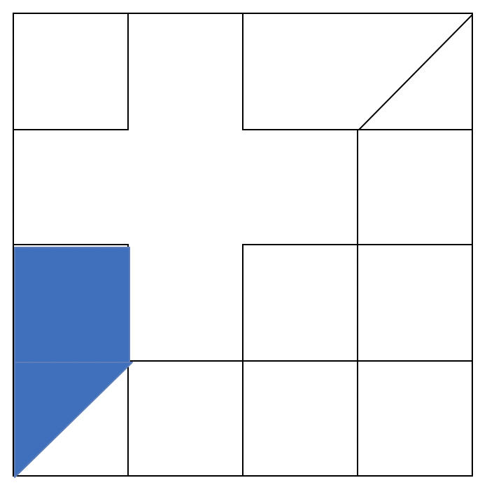
1.4.1 Warm-Up: Critical Thinking
A design is shown, where one part of the design is shaded.
What fraction of the diagram is shaded?
Explain how you determined your answer.
volume 1, pg. 19

Slide 7

Activity
volume 1, pg. 20

Slide 8

1.4.2 Collaboration: Card Sort
Work with your partner or group to match each expression with the integer chip model and number line model that represents the expression. Record your answers in the table. Then, use the models to determine the value of each expression.
volume 1, pg. 20

Slide 9
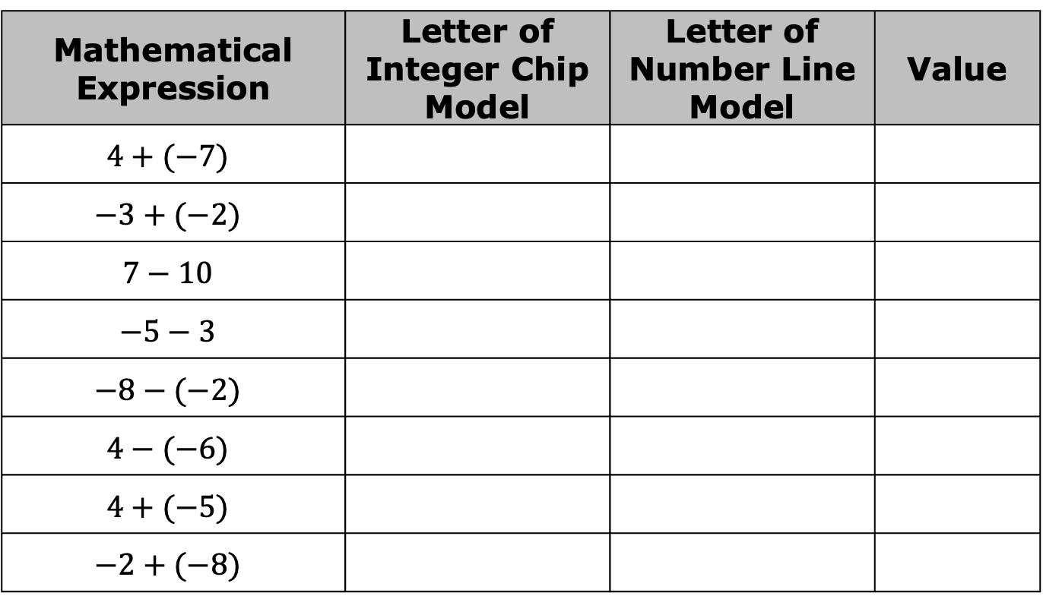
Mathematical Expression | Letter of Integer Chip Model | Letter of Number Line Model | Value
$$4+(−7)$$
$$−3+(−2)$$
$$7−10$$
$$−5−3$$
$$−8−(−2)$$
$$4−(−6)$$
$$4+(−5)$$
$$−2+(−8)$$
Explain the method you used to match the cards together.
volume 1, pg. 20

Slide 10

Guided Practice
volume 1, pg. 20

Slide 11

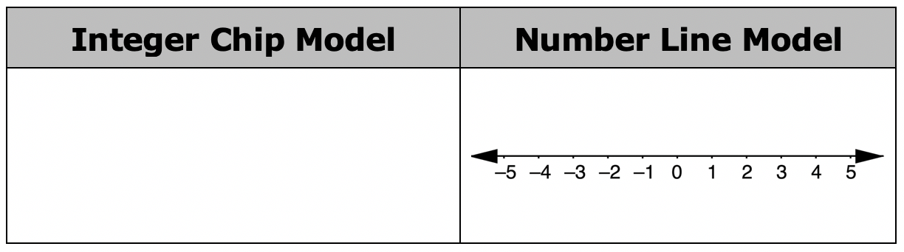

1.4.3 Guided Practice: Adding and Subtracting Integers
Model adding or subtracting the two integers by using the integer chip model and the number line model.
$5+\left(−2\right)= ___________$
volume 1, pg. 20

Slide 12
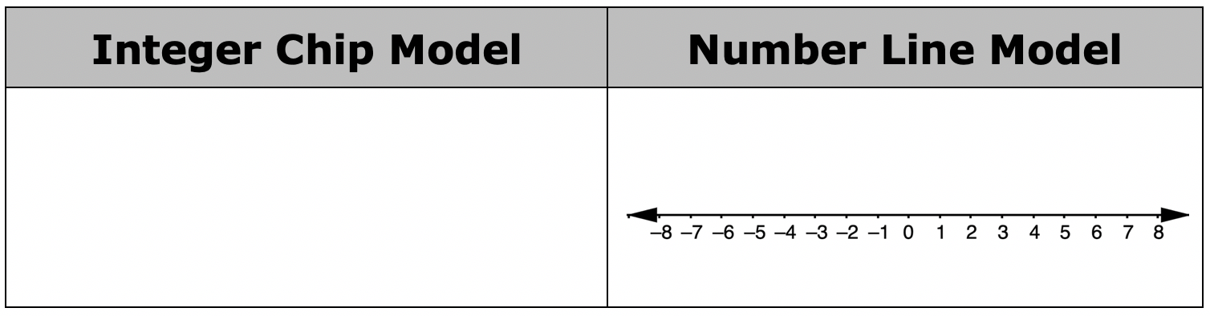


$−4 −3 = ___________$
$(−1)+\left(−2\right)= ___________$
volume 1, pg. 20

Slide 13
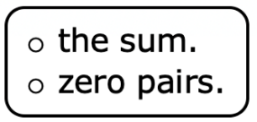
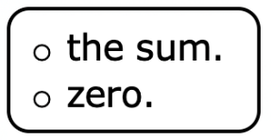
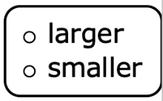
$−1 −(−4) = ___________$
Complete the statements.
When adding integers of different signs using the integer chip model, the smaller number of chips will combine with the same number of chips of the opposite sign to form The remaining chips show
The sum has the sign of the number of chips.
volume 1, pg. 21

Slide 14
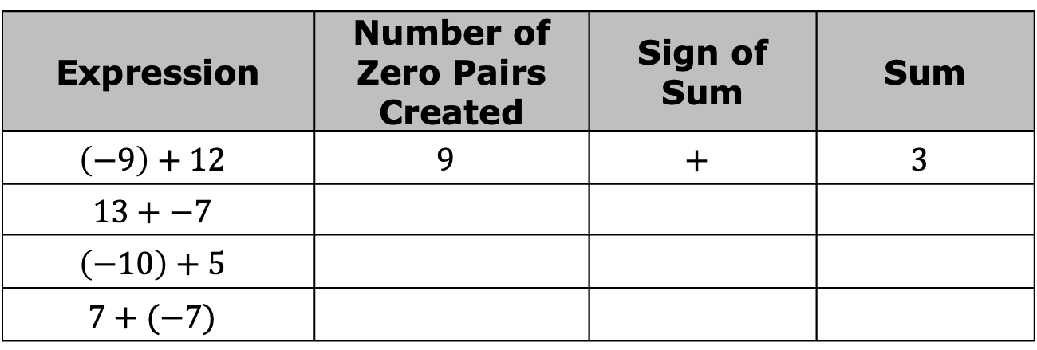
Complete the table.
Expression | Number of Zero Pairs Created | Sign of Sum | Sum
$$\left(−9\right)+12$$ | $$9$$ | $$+$$ | $$3$$
$$13+−7$$
$$\left(−10\right)+5$$
$$7+(−7)$$
volume 1, pg. 21

Slide 15

Bring It Together
volume 1, pg. 21

Slide 16

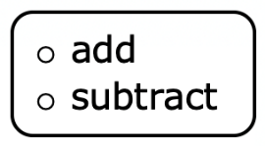
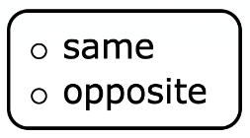
1.4.4 Bring It Together: Adding and Subtracting Integers
Complete the statements.
When adding integers of the same sign the absolute values of the integers. The sum will have the sign as the integers being added.
volume 1, pg. 21

Slide 17
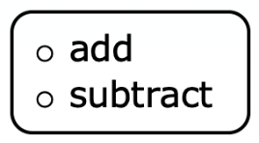

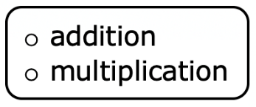
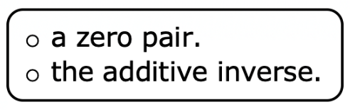
When adding integers of different signs, the absolute values of the integers. The sum will have the same sign as the integer with the absolute value.
When subtracting integers, create an equivalent expression by changing the expression to of
volume 1, pg. 21

Slide 18
Guided Practice
volume 1, pg. 22

Slide 19
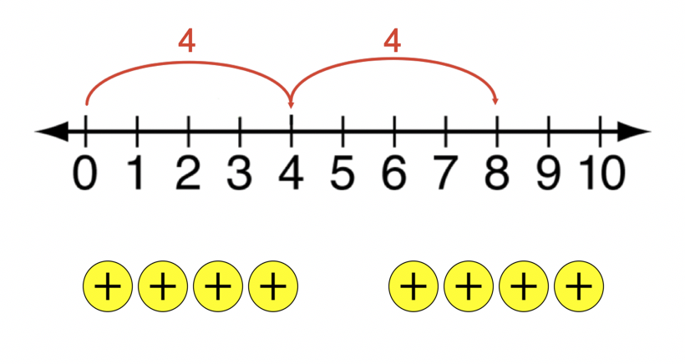
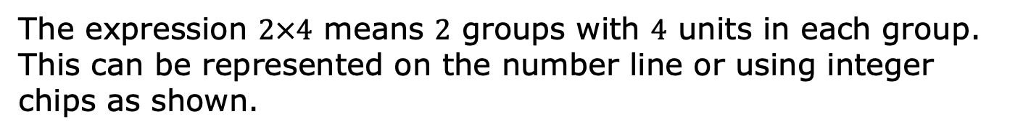
1.4.5 Guided Practice: Multiplying and Dividing Integers
The expression $2×4$ means $2$ groups with $4$ units in each group. This can be represented on the number line or using integer chips as shown.
volume 1, pg. 22

Slide 20
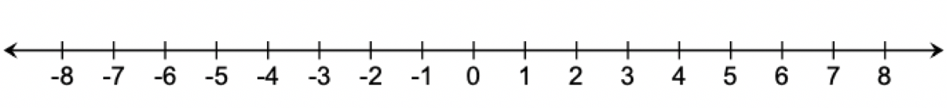

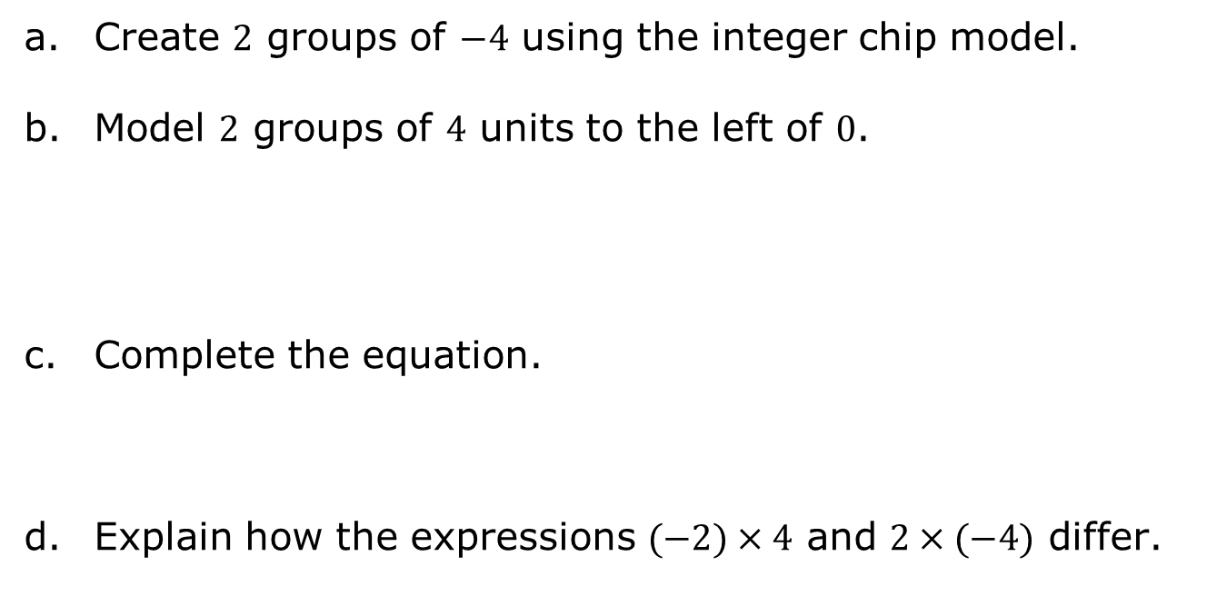
The expression $2×(−4)$ is given.
Create $2$ groups of $−4$ using the integer chip model.
Model $2$ groups of $4$ units to the left of $0$.
Complete the equation.
Explain how the expressions $(−2)×4$ and $2×(−4)$ differ.
$$2×\left(−4\right)=______$$
volume 1, pg. 22

Slide 21
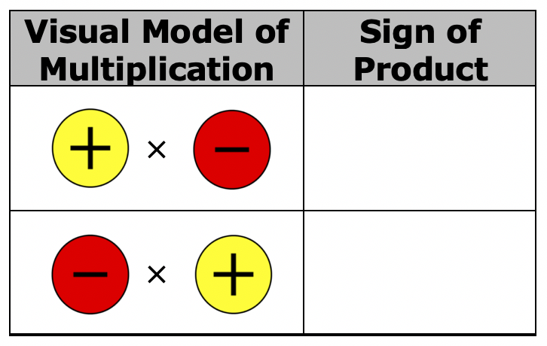
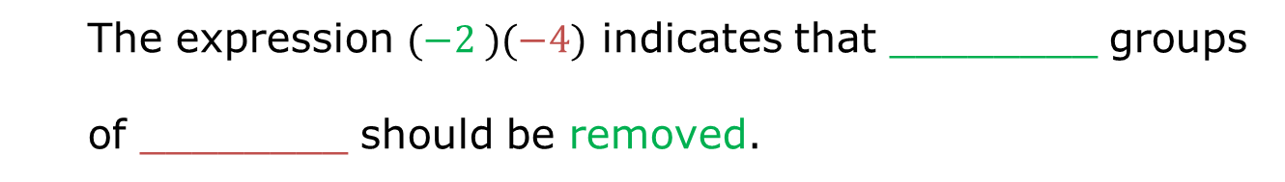
Complete the visual rule for multiplication of positive and negative numbers.
Complete the statement.
The expression $(−2 )(−4)$ indicates that ________ groups
of ________ should be removed.
volume 1, pg. 22

Slide 22
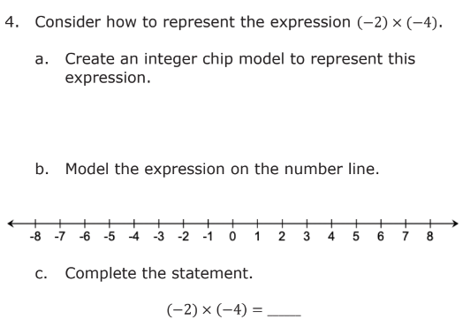
volume 1, pg. 22

Slide 23
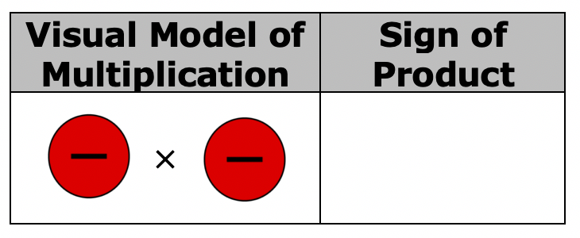
Complete the visual rule for the multiplication of two negative numbers.
volume 1, pg. 23

Slide 24
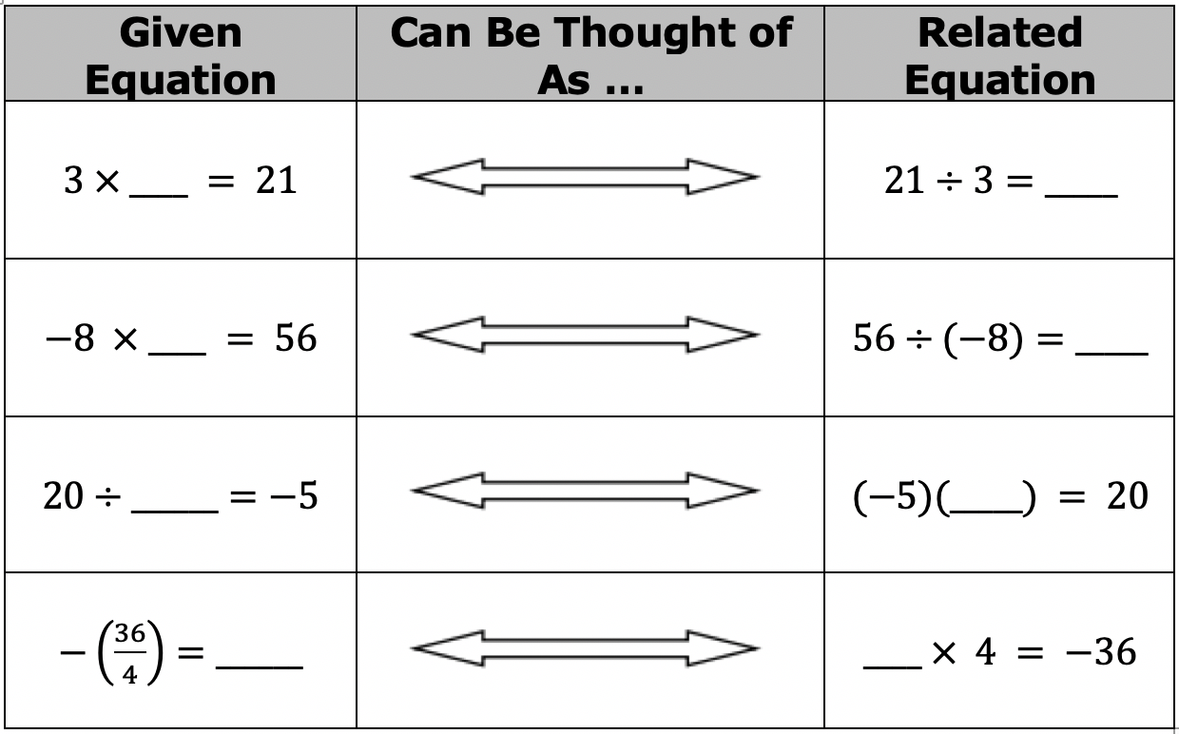
Multiplication and division have an inverse relationship. Use this relationship to complete the table.
How are the rules for multiplication of integers related to the rules for division of integers?
volume 1, pg. 23

Slide 25

Try It
volume 1, pg. 23

Slide 26

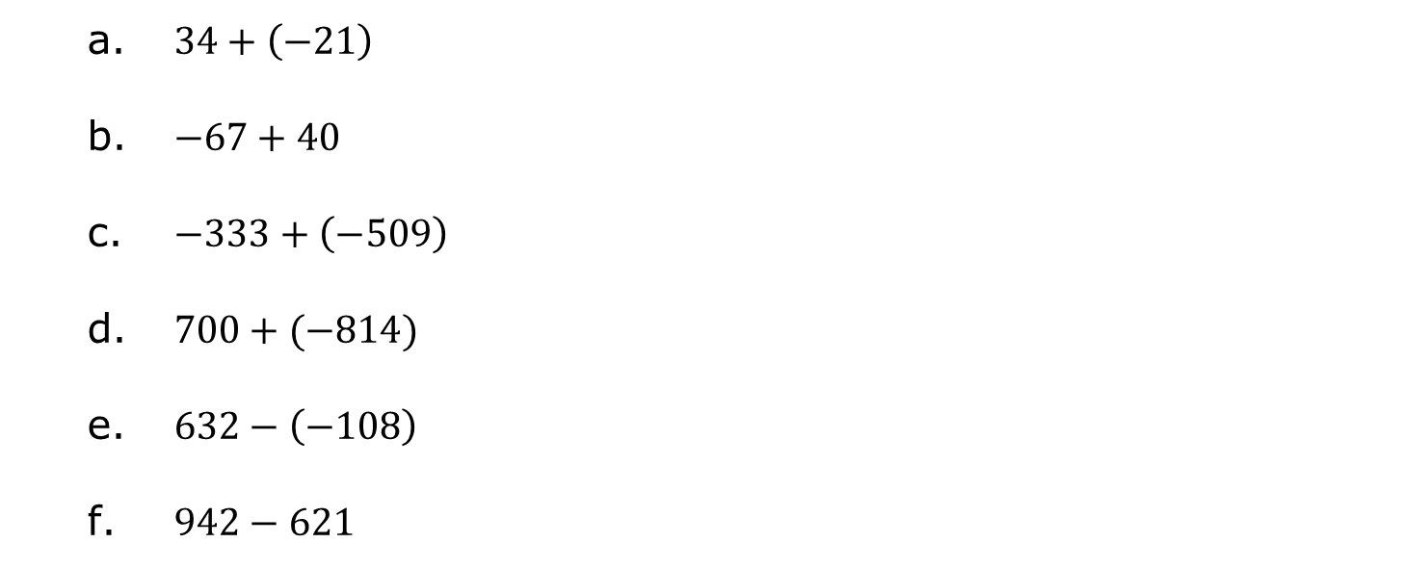
1.4.6 Try It: Integer Operations
Evaluate each expression.
$34+\left(−21\right)$
$−67+40$
$−333+\left(−509\right)$
$700+(−814)$
$632−\left(−108\right)$
$942−621$
volume 1, pg. 23

Slide 27

$−78−(−324)$
$105−\left(−75\right)$
$−5×\left(−6\right)$
$−22÷\left(−11\right)$
$−24÷3$
$9×(−4)$
volume 1, pg. 24

Slide 28

Wrap-Up
volume 1, pg. 24

Slide 29
1.4.7 Wrap-Up: Reflection
In this lesson, multiple concepts about operations with integers were reviewed. Rate yourself on the following skills based on your level of confidence.
Statement | Rating 1 – I struggle with this. 2 – I have some skills. 3 – I am almost there. 4 – I have got this!
I can add integers.
I can subtract integers.
I can multiply integers.
I can divide integers.
volume 1, pg. 24

